Slide 1
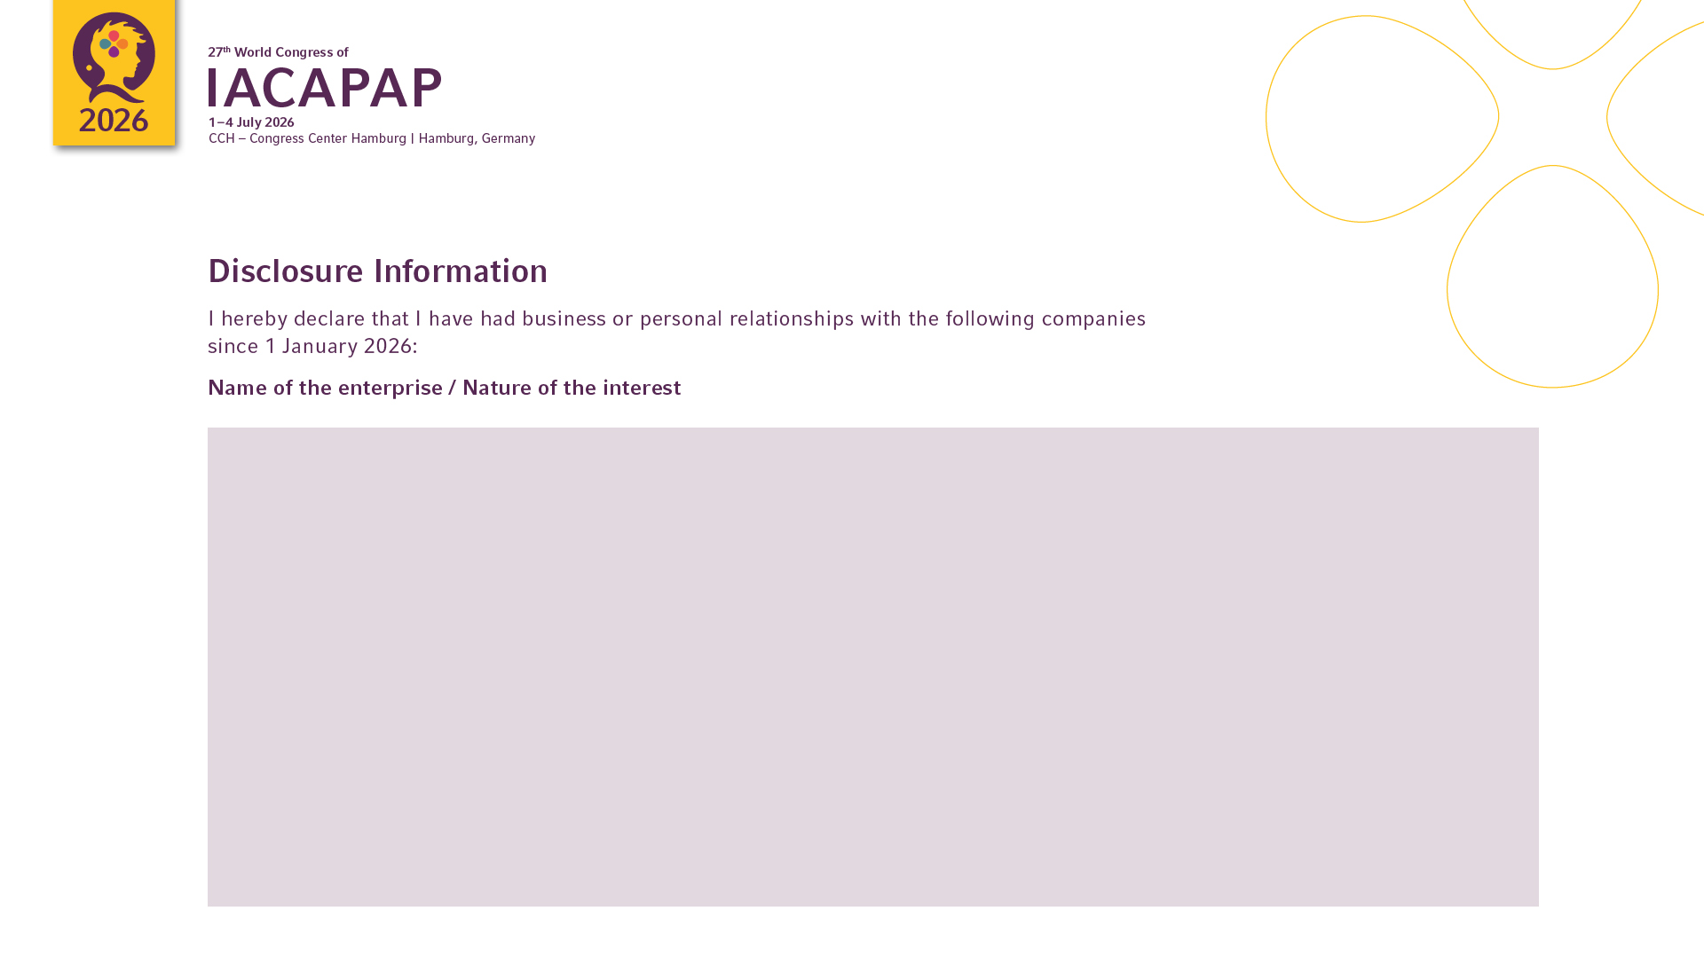
Enterprise | Interest
...

